Slide 1
SHT 31
Tarundeep kaur

Slide 2
Proposal
The goal of this project was to measure temperature and humidity levels using SHT31 sensor. SHT31 sensor is one of the most accurate device used for real time measurement of these levels.

Slide 3
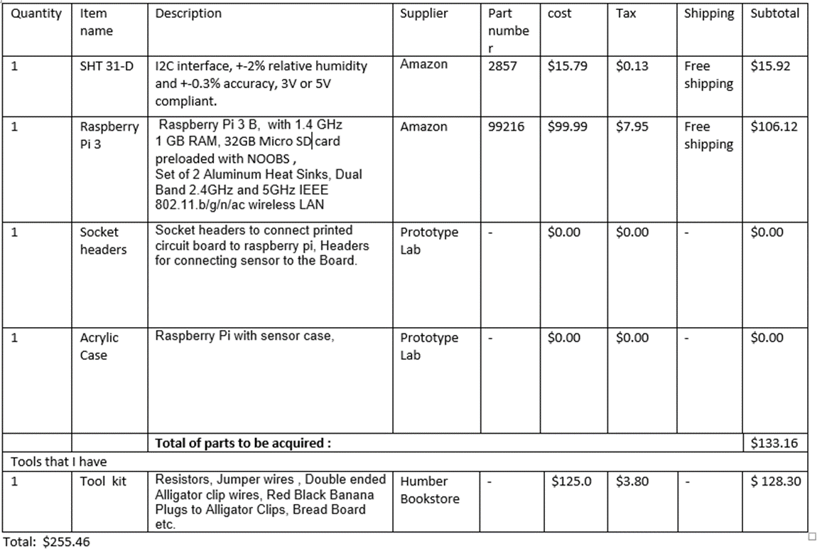
Budget

Slide 4
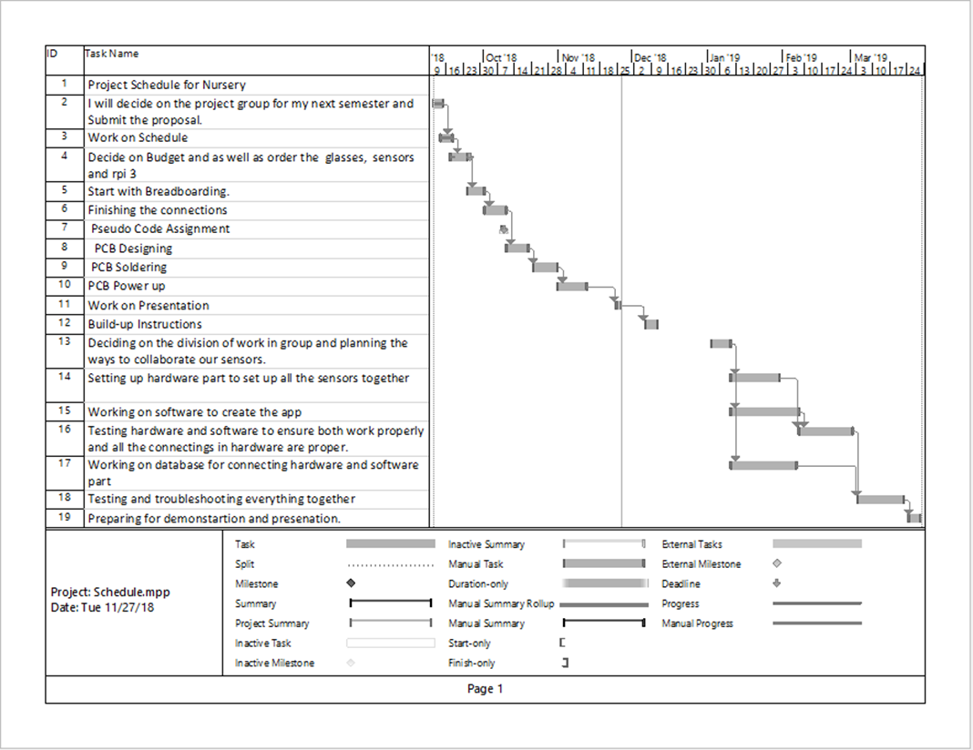
Schedule

Slide 5
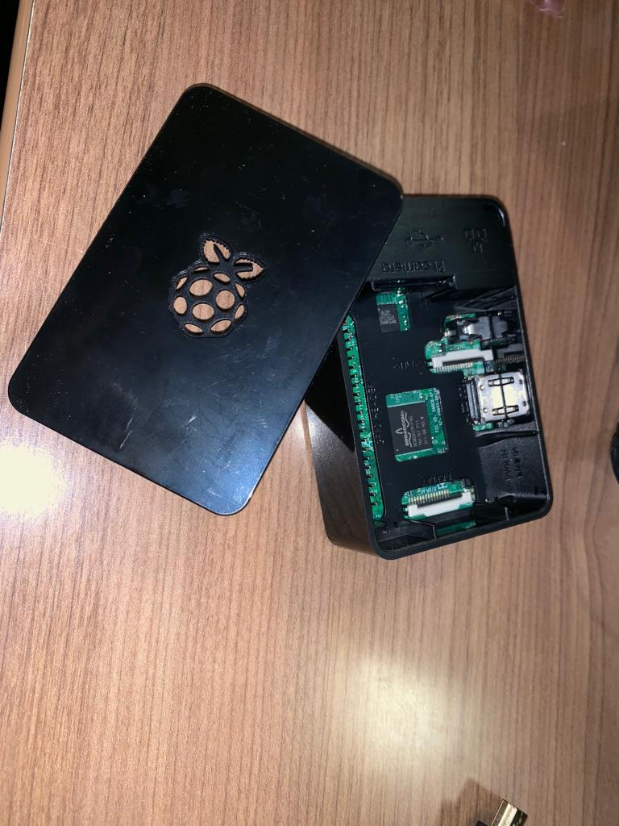
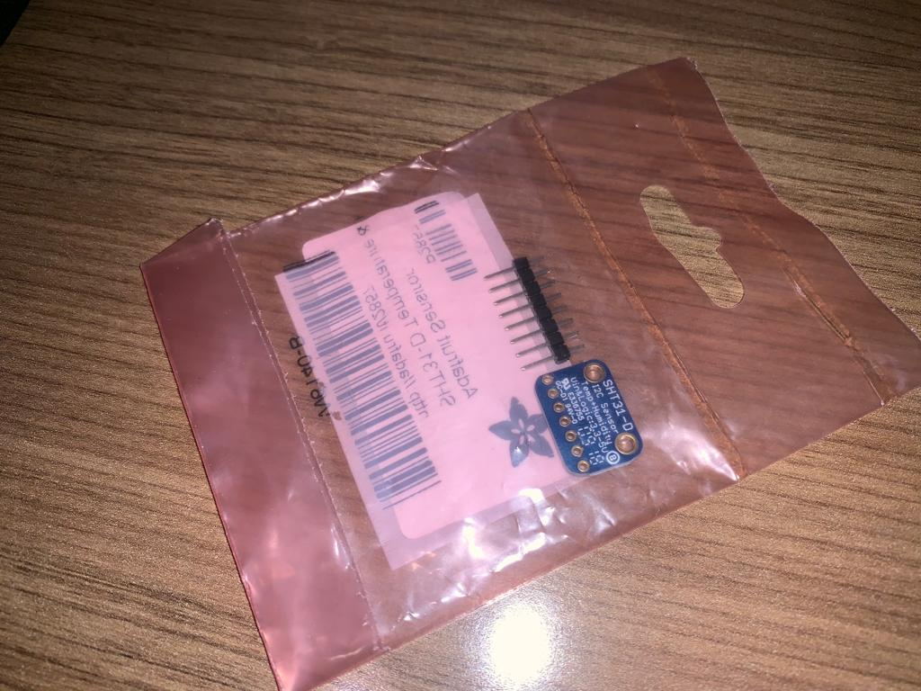
Hardware Components

Slide 6
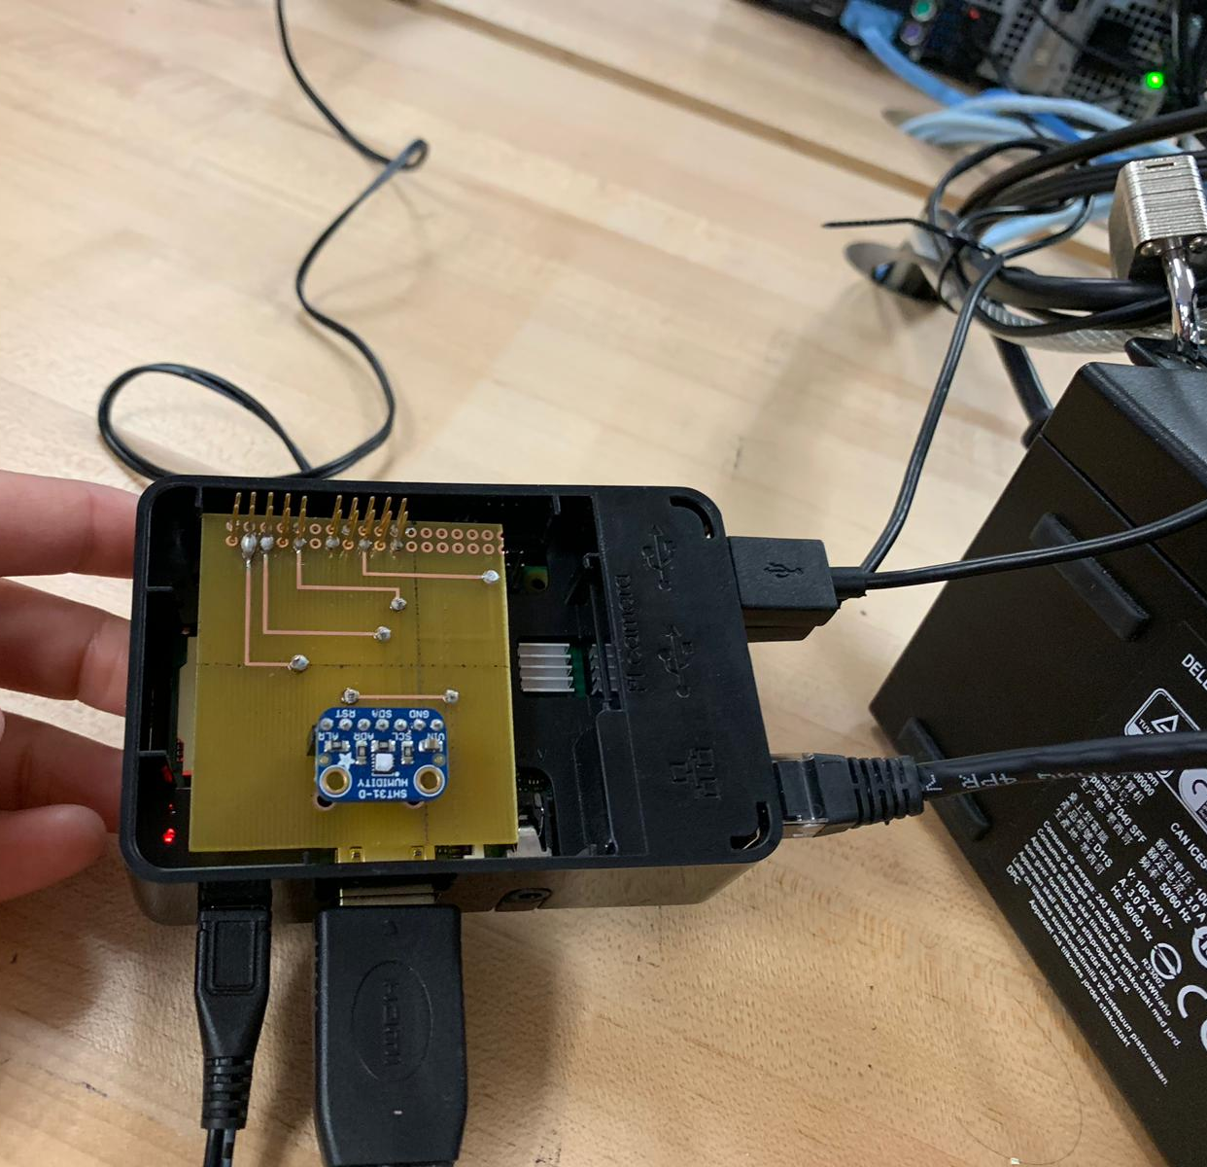
Initial Testing
Hardware components are attached to the pcb using socket headers.
An additional wire to vin and addr is attached so as to retrieve the required address.

Slide 7
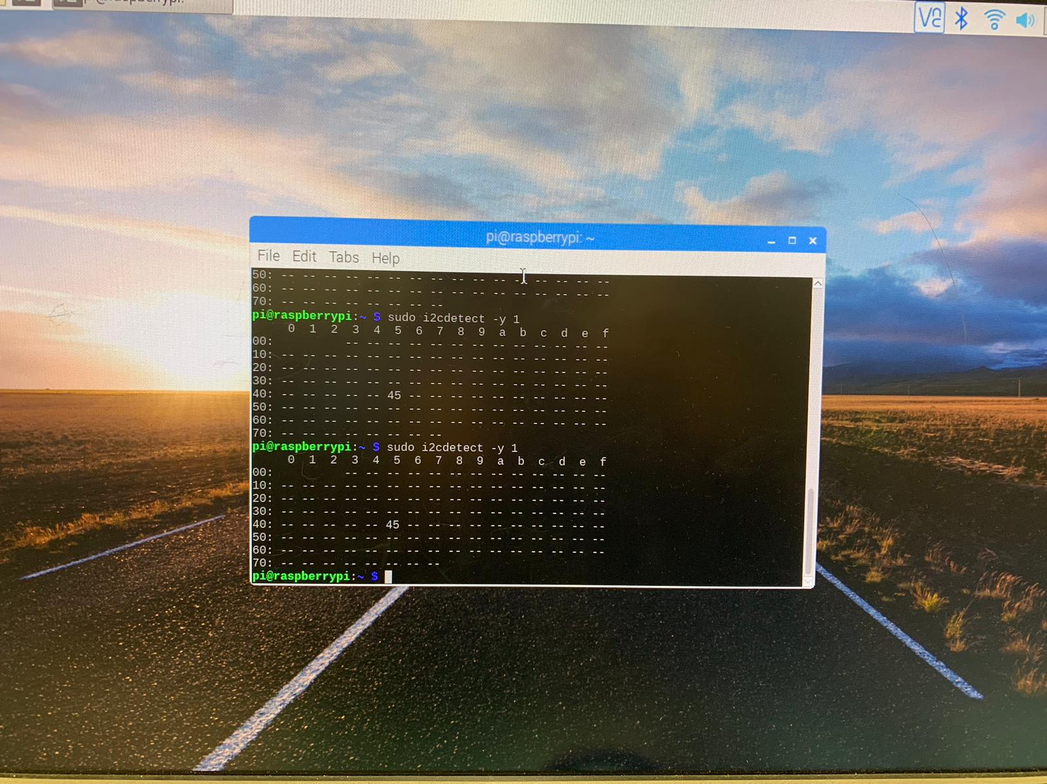
Address

Slide 8
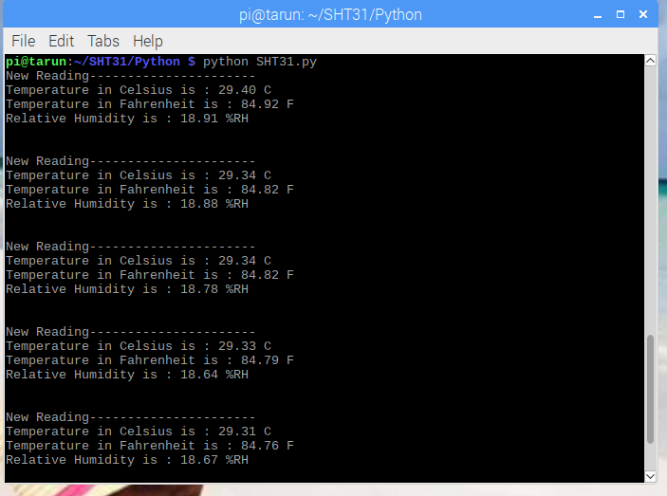
Readings

Slide 9
Related Courses
CENG 252: Embedded Systems
- Provided knowledge on how to work with a sensor.
ESOL 220: technical writing skills
- Improved writing skills.
CENG 209: Micro assembly Programming
-Provided knowledge on microcontrollers.

